Slide 1


Slide 2
Trainer Guidelines for Conducting Class
Solve questions live by creating new blank files (Excel, Python, Jupyter notebook, Dashboard) during the session, rather than sharing completed solutions.
Review teaching materials and solutions beforehand, and prepare additional examples to reinforce learning.
Ensure online students can hear you and see the screen clearly at all times.
Test your computer and necessary software before class begins.
Check with online students every 15-20 minutes to see if they understand the material and have any questions.

Slide 3

Instructor
Name:
Experience:
Proficiency:

Slide 4

.
SQL Roadmap
Day | Module | Hours
Day 1 | Introduction to SQL & Basic Querying | 3
Day 2 | Advanced Sql Concept & Data Manupulation | 3

Slide 5
Day 1: Agenda
Introduction to SQL
SQL's Significance
SQL Terminology
Database Systems
Creating Databases, Users and Tables
Inserting Data into Tables
SQL Data Types
Data Retrieval In SQL
Introduction to Data Models & ER Diagrams
Designing a Simple Database Schema
Temporary Tables
CTEs (Common Table Expressions)
Comments in SQL
Using Aliases for Column Names

Slide 6
Introduction to SQL
SQL (Structured Query Language): A language for handling relational databases.
Data Operations: SQL enables SELECT (retrieve), INSERT (add), UPDATE (modify), DELETE (remove) actions.
Database Structure: It defines and manages tables and their structure.
Queries: SQL is used to extract, filter, and manipulate data with SELECT statements.
Data Integrity: It enforces data accuracy through constraints and transactions.
Relational Databases: SQL is essential for managing data stored in relational database systems like MySQL, PostgreSQL, and Oracle.

Slide 7
SQL's Role in Data Retrieval and Manipulation
Retrieval: SQL SELECT statements fetch specific data from databases, with options for filtering, sorting, and aggregating.
Manipulation: SQL INSERT, UPDATE, and DELETE commands modify data, ensuring its accuracy and relevance.
Data Transformation: SQL allows for on-the-fly data transformations and calculations.
Data Integrity: SQL enforces rules through constraints, maintaining data consistency.
Transaction Control: SQL manages sequences of operations as single units, ensuring data reliability.
Indexing: SQL uses indexes to optimize data retrieval, improving query performance.

Slide 8
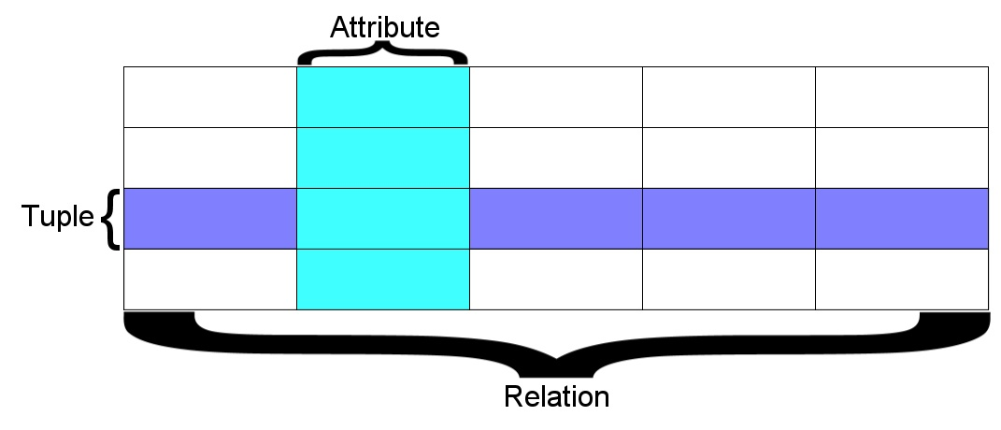
SQL Terminology
Database - contains one or more tables
Relation (or table) - contains tuples(rows) and attributes(columns)
Attribute (column or field) - one of possibly many elements of data corresponding to the object represented by the row
Tuple (or row) - a set of fields which generally represent an “object” like a person or a music track

Slide 9
Database Systems
A Database Management System (DBMS) is a software tool that helps you organize and manage information electronically. It's like a digital filing cabinet that lets you store, retrieve, and modify data in a structured way.
Major Database Management Systems
MySQL - Fast and scalable - commercial open source.(Sun Microsystems/Oracle)
PostgreSQL – 100% Open source, feature rich.
Oracle - Large, commercial, enterprise-scale, very tweakable.
SqlServer - from Microsoft.(also Access)
Smaller projects: SQLite, HSQL, …

Slide 10
CREATING A DATABASE
The first step is to create a database, inside which we can store multiple tables(relations).
E.g. We want to store employee information that will have multiple tables, such as their personal information, their roles, their working hours and pay. All this table will be organized together and saved in a single unit known as a Database.
To create a database in SQL, use the CREATE DATABASE statement.
CREATE DATABASE database_name;
CREATE DATABASE: This statement is used to create a new database.
database_name: Replace this with the desired name for your table.
Create a simple "Employee" Database.
CREATE DATABASE Employee;
In this example, we create a database named "Employee" which will store any information related to employees.

Slide 11
CREATING A USER
We create users in a database to give control access and grant specific permissions. To interact with a database we need a user who has the required permission to access that database.
To create a user in SQL, use the CREATE USER statement.
CREATE USER 'username'@'host' IDENTIFIED BY 'password’;
`username`: Choose a username for the user account.
`host`: Specify the host from where the user can connect. (Use 'localhost' for connections from the same machine as MySQL. Use '%' (wildcard) for allowing connections from any host (less secure).)
`password`: Set a strong password for the user account.
Create a simple “emp_admin" user.
This user will be able to interact and manage the data in the admin database table.
CREATE USER ‘emp_admin'@'localhost' IDENTIFIED BY 'secure_password';

Slide 12
Granting Permission
Grant all permission to “emp_admin" user.
Since this is a admin user this user will have access to do everything in this database.
GRANT ALL ON employee.* TO 'emp_admin’@’localhost';
After creating a user you have to specify what database they can access and what actions they can perform in that database.
To grant permissions to a user in SQL, use the GRANT statement.
GRANT `permission_list` ON database_name.* TO 'username'@'host’;
`permission_list`: Comma-separated list of permissions (e.g., ALL, SELECT, INSERT, UPDATE, DELETE). Choose the permissions based on what the user needs to do with the database.
`database_name`: The name of the database you created.
`username` and `host`: Same as user creation step.
Grant Read only.
We can also limit permissions by manually specifying them instead of using ‘ALL’.
GRANT SELECT ON employee.* TO ‘username’@’localhost’;
(Above code only allows the user to perform SELECT operations)

Slide 13
CREATE TABLE in SQL
To create a table in SQL, you use the CREATE TABLE statement.
CREATE TABLE table_name (
column1 datatype constraint,
column2 datatype constraint,
...
);
CREATE TABLE: This statement is used to create a new table.
table_name: Replace this with the desired name for your table.
column1, column2, ...: List the columns you want to include in the table, along with their names and data types.
datatype: Specify the data type for each column, such as INT, VARCHAR, DATE, etc.
constraint: You can add constraints like primary keys, foreign keys, unique constraints.
Create a simple "Employees" table
CREATE TABLE Employees (
EmployeeID INT PRIMARY KEY,
FirstName VARCHAR(50),
LastName VARCHAR(50),
HireDate DATE,
Salary DECIMAL(10, 2)
);
In this example, we create a table named "Employees" with columns for employee ID, first name, last name, hire date, and salary. The "EmployeeID" column is defined as the primary key to ensure unique identification of each employee.

Slide 14
INSERT Data into Tables
To INSERT data into a table in SQL, you use the statement.
INSERT INTO table_name (column1, column2) VALUES (‘value1', ‘value2');
INSERT INTO table_name: This specifies which table we want to insert the data into.
(column1, column2): This defines the columns in the table that we're inserting data into.
VALUES (‘value1', ‘value2'): This defines the actual values we're inserting into the previously mentioned column.
Insert values inside the "Employees" table
INSERT INTO employee (first_name, last_name) VALUES ('John', 'Doe');
In this example, we added ‘John’, ’Doe’ into the ‘first_name’ and ‘last_name’ columns of the employees table

Slide 15
Data Types in SQL
Everything we insert into a database has a specific data type.
They are divided into:
Text fields
Binary fields
Numeric fields
Date fields
Text Data Types:
CHAR: Stores fixed-length character strings. Good for short, important data with a predetermined length. (Example: Initials (3 characters), product codes (10 characters))
VARCHAR: Stores variable-length character strings. More efficient for text that can vary in length. (Example: Product names, customer addresses)
TEXT/BLOB: These are used for very large text or binary data. Choose the appropriate one based on your needs.
TEXT (TINYTEXT, MEDIUMTEXT, LONGTEXT): Stores large textual data like essays or descriptions.
BLOB (TINYBLOB, MEDIUMBLOB, LONGBLOB): Stores large binary data like images, audio, or video files.

Slide 16
Data Types in SQL
Numeric Data Types:
INT (INTEGER): Stores whole numbers, positive, negative, or zero. (Example: Employee IDs, product quantities)
DECIMAL: Stores numbers with decimals for precise values. (Example: Product prices, account balances)
FLOAT/DOUBLE: Stores numbers with decimals, good for very large or small values, but less precise than DECIMAL. (Example: Scientific measurements, geographical coordinates)
Date and Time Data Types:
DATE: Stores year, month, and day in the format YYYY-MM-DD. (Example: Order dates, birth dates)
TIME: Stores hours, minutes, and seconds in the format HH:MM:SS. (Example: Flight times, meeting times)
DATETIME: Combines DATE and TIME information, storing both date and time values. (Example: Login timestamps, transaction timestamps)

Slide 17
SELECT Statement for Data Retrieval
A basic SELECT statement in SQL is used for data retrieval. It allows you to specify the columns you want to retrieve and the table from which you want to retrieve the data
SELECT column1, column2
FROM table_name;
SELECT: Retrieves data from the database.
column1, column2: Specifies the columns you want to retrieve (you can select multiple by separating with commas).
FROM: Specifies the table you're retrieving data from by replacing it with the actual table name.
For example, if you have a table named "employees" with columns "first_name" and "last_name," you can retrieve the names of all employees using the following SQL statement:
SELECT first_name, last_name
FROM employees;

Slide 18
Retrieving Specific Columns and All Columns
Retrieving Specific Columns:
SELECT column1, column2
FROM table_name;
Example
SELECT first_name, last_name
FROM employees;
This code retrieves only the first_name and last_name columns from the "employees" table
Retrieving All Columns:
SELECT *
FROM table_name;
Example:
SELECT *
FROM products;
This code retrieves all columns (all data) from the "products" table.

Slide 19
DISTINCT to Remove Duplicates
In SQL, you can use the DISTINCT keyword to remove duplicate rows from the result set when querying a table.
SELECT DISTINCT column1, column2
FROM table_name;
SELECT DISTINCT: Gets unique rows based on specified columns, ensuring only distinct value combinations are returned.
column1, column2: Specify the columns for uniqueness, and multiple columns must create unique combinations.
FROM table_name: Specifies the source table for data retrieval.
Example:
Let's say you have a "customers" table with a "city" column, and you want to retrieve a list of unique cities from the table:
SELECT DISTINCT city
FROM customers;
This query would return a list of unique cities from the "customers" table, removing any duplicate city names. It's a handy way to quickly identify unique values within a specific column.

Slide 20
Data Model in SQL
In SQL, a data model refers to the structure and organization of data within a relational database. The data model in SQL is typically represented using tables, where each table represents an entity, and columns within the table represent attributes or properties of that entity.
Key components:
Tables: Represent real-world entities, with rows and columns to store data.
Columns: Define attributes with data types (e.g., text, numbers).
Primary Keys: A column with unique identification value for each row.
Foreign Keys: A columns that contains the relative primary key of another table.
Relationships: Define how tables are related (e.g., one-to-one, one-to-many).
Constraints: Enforce data integrity rules (e.g., uniqueness, checks).

Slide 21
Data Model in SQL
-- Customers table
CREATE TABLE Customers (
CustomerID INT PRIMARY KEY,
FirstName VARCHAR(50),
LastName VARCHAR(50),
Email VARCHAR(100)
);
-- Orders table with a foreign key to Customers
CREATE TABLE Orders (
OrderID INT PRIMARY KEY,
CustomerID INT REFERENCES Customers(CustomerID),
OrderDate DATE,
TotalAmount DECIMAL(10, 2)
);
In this example, there are two tables: "Customers" and "Orders," with a foreign key relationship between them. The data model is designed to store information about customers and their orders, demonstrating the key concepts of a data model in SQL.​

Slide 22
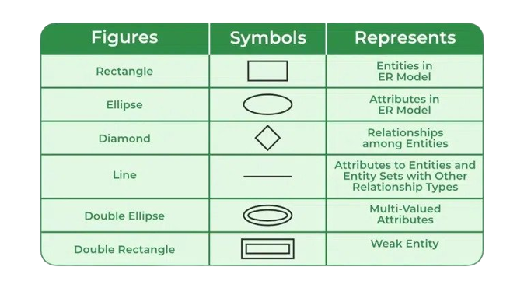
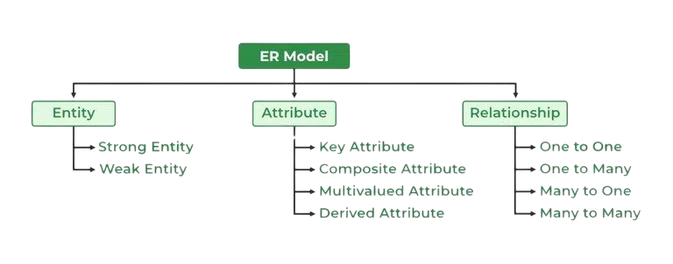
Data Model & ER Diagram
A data model is a conceptual framework that defines how data is organized and structured within a database system. It serves as a blueprint for designing databases and describes entities, attributes, relationships, and constraints.
An Entity-Relationship (ER) diagram, on the other hand, is a visual representation of this data model. It uses standardized symbols and notations to depict entities, their attributes, relationships, and the cardinality of these relationships

Slide 23
Data Model in SQL
Data Model
CREATE TABLE Authors (
AuthorID INT PRIMARY KEY,
AuthorName VARCHAR(100)
);
CREATE TABLE Books (
BookID INT PRIMARY KEY,
Title VARCHAR(255),
AuthorID INT,
FOREIGN KEY (AuthorID) REFERENCES Authors(AuthorID)
);
CREATE TABLE Customers (
CustomerID INT PRIMARY KEY,
CustomerName VARCHAR(100)
);
CREATE TABLE BorrowedBooks (
BorrowID INT PRIMARY KEY,
CustomerID INT,
BookID INT,
BorrowDate DATE,
ReturnDate DATE,
FOREIGN KEY (CustomerID) REFERENCES Customers(CustomerID),
FOREIGN KEY (BookID) REFERENCES Books(BookID)
);
In this simplified example, we have tables for "Authors," "Books," "Customers," and "BorrowedBooks," with relationships between them. The ER diagram is represented in text, showing the relationships between the entities. However, for real-world applications, ER diagrams are usually created using visual diagramming tools designed for this purpose.

Slide 24
Designing a Simple Database Schema
1. Books Table:
The Books table will store information about each book available in the bookstore.
book_id (Primary Key): A unique identifier for each book.
title: The title of the book.
author_id (Foreign Key): A reference to the author of the book.
publication_year: The year the book was published.
price: The price of the book.
stock_quantity: The number of copies in stock
CREATE TABLE Books (
book_id INT PRIMARY KEY,
title VARCHAR(255) NOT NULL,
author_id INT,
publication_year INT,
price DECIMAL(10, 2),
stock_quantity INT
);

Slide 25
Designing a Simple Database Schema
2. Authors Table:
The Authors table will store information about the authors of the books.
author_id (Primary Key): A unique identifier for each author.
author_name: The name of the author.
CREATE TABLE Authors (
author_id INT PRIMARY KEY,
author_name VARCHAR(255) NOT NULL
);

Slide 26
Designing a Simple Database Schema
3. Orders Table:
The Orders table will keep track of customer orders.
order_id (Primary Key): A unique identifier for each order.
customer_id: A reference to the customer who placed the order.
order_date: The date when the order was placed.
book_id (Foreign Key): A reference to the book ordered.
quantity: The number of copies of the book ordered.
CREATE TABLE Orders (
order_id INT PRIMARY KEY,
customer_id INT,
order_date DATE,
book_id INT,
quantity INT,
FOREIGN KEY (customer_id) REFERENCES Customers(customer_id),
FOREIGN KEY (book_id) REFERENCES Books(book_id)
);

Slide 27
Designing a Simple Database Schema
In this schema:
The Books table has a foreign key relationship with the Authors table using the author_id column. This allows us to associate each book with its respective author.
The Orders table has foreign key relationships with both the Customers and Books tables. This links each order to a specific customer and the book(s) they ordered.
Primary keys are unique identifiers for each table (e.g., book_id, author_id, and order_id).
Foreign keys (e.g., author_id, customer_id, and book_id) establish relationships between tables, ensuring data integrity and referential integrity.

Slide 28
Temporary Tables
Temporary tables are a type of database table that is used to store and manipulate data temporarily within the scope of a database session or a specific transaction.
Creating Temporary Tables:
CREATE TEMPORARY TABLE temp_table_name (
column1 datatype,
column2 datatype,
...
);
Using Temporary Tables:
-- Insert data into the temporary table
INSERT INTO temp_employee (id, name)
VALUES (1, 'John'), (2, 'Alice');
-- Query the temporary table
SELECT * FROM temp_employee;
-- Perform additional operations as needed
-- The temporary table will be automatically dropped when the session or transaction ends

Slide 29
CTEs in SQL
What are CTEs?
Common Table Expressions (CTEs) are temporary result sets that exist only for the duration of the query in which they are defined. They are essentially a way to create a temporary view or subquery that can be referenced multiple times within a single SQL statement.
Syntax
The basic syntax for defining a CTE is
WITH cte_name (column_list) AS (
-- CTE query
)
-- Main query that references the CTE
Example:
Let's say we have an employees table with columns employee_id, name, department, and salary. We can use a CTE to calculate the average salary for each department:
WITH dept_avgs AS (
SELECT department, AVG(salary) AS avg_salary
FROM employees
GROUP BY department
)
SELECT e.name, e.department, e.salary, a.avg_salary
FROM employees e
JOIN dept_avgs a ON e.department = a.department;

Slide 30
Comments to SQL Code
Single-Line Comments:
-- This is a single-line comment in SQL
SELECT column1, column2
FROM my_table; -- Another comment here
Multi-Line Comments:
/* This is a multi-line comment in SQL.
It can span multiple lines and is useful
for providing detailed explanations. */
SELECT column1, column2
FROM my_table;

Slide 31
Using Aliases for Column Names
In SQL, you can use column aliases to give temporary names to the columns in the result set of a query. Column aliases can make query results more readable and provide meaningful names for computed or aggregated values.
SELECT column_name AS alias_name
FROM table_name;
Example:
Suppose you have an "Employees" table with columns "FirstName" and "LastName," and you want to create an alias for the "FirstName" column to make it more descriptive:
SELECT FirstName AS EmployeeFirstName, LastName
FROM Employees;
In this query, the AS keyword is used to create an alias "EmployeeFirstName" for the "FirstName" column. The result set will include a column named "EmployeeFirstName" instead of "FirstName" while keeping the "LastName" column name unchanged.
AS: The AS keyword is optional but often used to indicate the start of the alias.
alias_name: The temporary name you want to assign to the column.
FROM: Specifies the table from which you want to retrieve data.
table_name: Replace with the actual name of the table.

Slide 32
Thank You!!!

